Slide 1
OPERATING SYSTEM
PROCESS SCHEDULING

Slide 2
PROCESS SCHEDULING
There are many scheduling queues that are used to handle processes.
When the processes enter the system, they are put into the job queue.
The processes that are ready to execute in the main memory are kept in the ready queue.
The processes that are waiting for the I/O device are kept in the device queue.

Slide 3
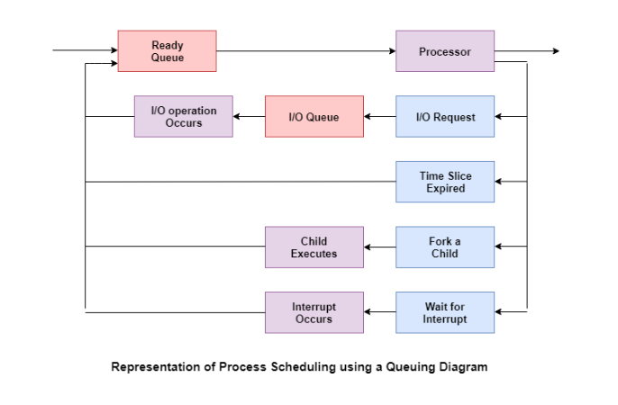
DIAGRAM OF PROCESS SCHEDULING

Slide 4
TYPES OF PROCESS SCHEDULING
LONG TERM SCHEDULER
The job scheduler or long-term scheduler selects processes from the storage pool and loads them into memory for execution.
The job scheduler must select a careful mixture of I/O bound and CPU bound processes to yield optimum system throughput.
If it selects too many CPU bound processes then the I/O devices are idle and if it selects too many I/O bound processes then the processor has nothing to do.

Slide 5
SHORT TERM SCHEDULER
The short-term scheduler selects one of the processes from the ready queue and schedules them for execution.
The short-term scheduler executes much more frequently than the long-term scheduler as a process may execute only for a few milliseconds.

Slide 6
MEDIUM TERM SCHEDULER
The medium-term scheduler swaps out a process from main memory.
It can again swap in the process later from the point it stopped executing.
This is helpful in reducing the degree of multiprogramming.
Swapping is also useful to improve the mix of I/O bound and CPU bound processes in the memory.

Slide 7
CONTEXT SWITCHING
Removing a process from the CPU and scheduling another process requires saving the state of the old process and loading the state of the new process.
This is known as context switching.
The context of a process is stored in the Process Control Block (PCB) and contains the process register information, process state, and memory information.
The dispatcher is responsible for context switching.
It saves the context of the old process and gives control of the CPU to the process chosen by the short-term scheduler.

